Slide 1
B + TREE
By
Mrs. Amruta Hngmire
RSCOE, Pune.

Slide 2
INTRODUCTION
A B+ tree is a balanced tree in which every path from the root of the tree to a leaf is of the same length, and each non leaf node of the tree has between [n/2] and [n] children, where n is fixed for a particular tree.
In a B+ tree, in contrast to a B-tree, all records are stored at the leaf level of the tree; only keys are stored in internal nodes.
All the leaf nodes are interconnected for faster access.
Fill factor is 50%.

Slide 3
Example
B+ Trees use a "fill factor" to control the growth and the shrinkage. A 50% fill factor would be the minimum for any B+.
Example : A B+ tree of order 5.
Number of Keys 4
Number of Pointers 5
Fill Factor 50%
Minimum Keys in each node 2

Slide 4
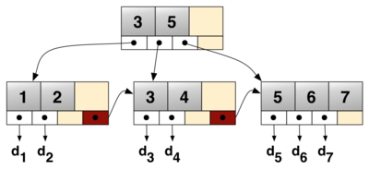
B+ TREE
INTERNAL NODE / INDEX nodeS
LEAF NODES / DATA nodeS
The linked list allows rapid in-order traversal.

Slide 5
OPERATIONS IN B+ TREE
SEARCH
INSERTION
DELETION

Slide 6
B+ TREE- SEARCH OPERATION
TWO CASES:
Successful Search
Unsuccessful Search

Slide 7
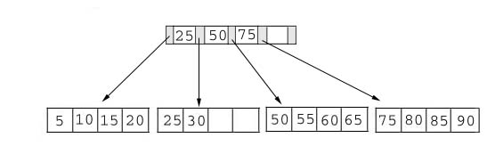
Searching
Compare the key value with the data in the tree, then give the result back.
For example: find the value 45, and 15 in below tree.

Slide 8
B+ TREE- INSERTION OPERATION
Inserting a record when
Case 1:If both leaf node and index node is not full.
Case 2:If leaf node is full and index node is not full.
Case 3:If both leaf node and index node is full.

Slide 9
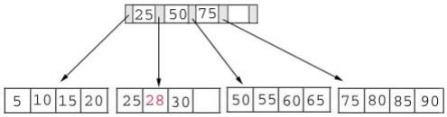
INSERTION –CASE 1
Add Record with Key 28

Slide 10
INSERTION –CASE 2
Adding a record when the leaf node is full but the index node is not full.
Add Record with Key 70

Slide 11
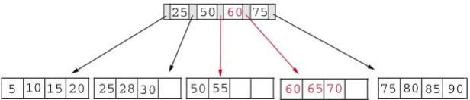
This record should go in the leaf node containing
50, 55, 60, and 65.
Left Leaf node Right Leaf node
50 55 60 65 70
AFTER INSERTING A Record With Key 70.

Slide 12
INSERTION –CASE 3
Adding a record when both the leaf node and the index node are full.
Add a record containing a key value of 95 to the following tree.

Slide 13
This record belongs in the node containing 75, 80, 85, and 90. Since this node is full we split it into two nodes:
Left Leaf Node Right Leaf node
75 80 85 90 95
The middle key, 85, rises to the index node.
But the index node is also full, so we split the index node:
Left Index node Right Index node New Index node
25 50 75 85 60

Slide 14
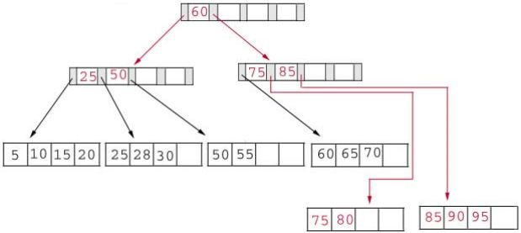
After the record containing 95 is inserted.
Leaf nodes are at same level only.

Slide 15
B+ tree – Deletion Operation
Deleting a record from B+ tree may result in
Case 1: If both the leaf node and index node does not go below the fill factor.
Case 2: If the leaf node goes below fill factor and index node does not go below the fill factor.
Case 3: If both the leaf node and index node goes below the fill factor.

Slide 16
DELETION –CASE 1
If both the leaf node and index node does not go below the fill factor.
Delete 70 from the following B+ Tree

Slide 17
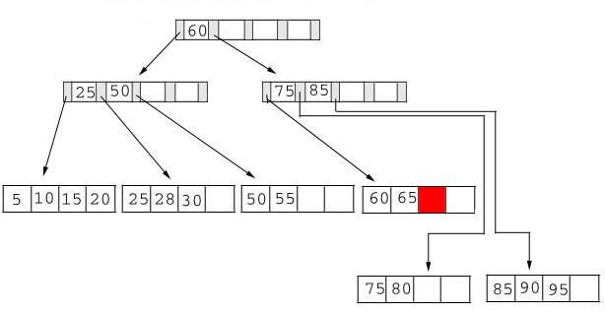
This node will contain 2 records after the deletion. So, simply delete 70 from the leaf node.

Slide 18
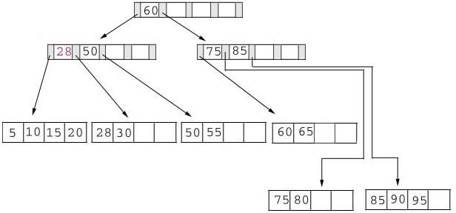
Delete 25 from the B+ tree
when we delete 25 we must replace it with 28 in the index node.

Slide 19
Delete 60 from the B+ tree
The leaf node containing 60 will be below the fill factor after the deletion. Thus, we must combine leaf nodes.
With recombined nodes, the index node will be reduced by one key. Hence, it will also fall below the fill factor. Thus, we must combine index nodes.
60 appears as the only key in the root index node.

Slide 20
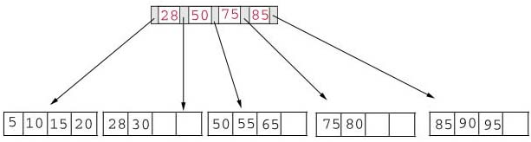
After deleting 60

Slide 21
B+ TREES AS FILE INDEXES
B+ Trees are descendants of B Trees.
Retrieval of records from large files or databases stored in external memory is time consuming.
To promote Efficient Retrievals, file indexes are used.
An index is a <Key , Address> pair.

Slide 22
The records of the file are sequentially stored and for each block of records, the largest key and the block address is stored in an index.
In B+ Tree to retrieve a record given its key, it is essential that the search traverses down to a leaf node to retrieve its address.
The non leaf nodes only serve to help the process traverse downwards towards the appropriate leaf node.

Slide 23
Advantage of B+ tree
B+ Trees are much easier and higher performing to do a full scan, since the terminal nodes form a linked list.
But to do a full scan in B tree, a complete inorder traversal is to be made.
Any search will end at leaf node only.
Time complexity for every search results in O(h).
H-height of the B+ tree.
Waste of Memory.
In comparing to B+ trees, B trees are efficient.
Disadvantage of B+ tree

Slide 24
THANK YOU

